Slide 1
Project Management
Seminar

Slide 2
Objective
Get acquainted to the Project management process area and the application Development in different MNCs and SMEs over the world.

Slide 3
Projects & operations
A temporary endeavor undertaken to create a unique product or service
Every project has a definite beginning and a definite end
Different in some distinguishing way from all similar entities
Therein, lies the difference between
operations and projects

Slide 4
Why Do I need a training on Project Management Along with Coding / Software Engineering?
Projects progress rapidly until they are 90 percent complete. Then they remain 90 percent complete forever, no matter how much manpower and money you add.
Immutable Laws of Project Management

Slide 5
Immutable Laws of Project Management
LAW 5: Measurable benefits are real. Intangible benefits are not measurable, thus intangible benefits are not real.
Intangible benefits are real if you can prove that they are real.
LAW 6: Anyone who can work effectively on a project part-time certainly does not have enough to do now.
If a boss will not give a worker a full-time job, you shouldn’t either.
If the project participant has a time conflict, the work given by the full-time boss will not suffer.
LAW 7: The greater the project’s technical complexity, the less you need a technician to manage it.
Get the best manager you can. The manager will get the technicians.
The reverse of corollary 1 is almost never true.
LAW 8: A carelessly planned project will take three times longer to complete than expected. A carefully planned project will only take twice as long.
If nothing can possibly go wrong, it will anyway. (See Murphy’s laws)
Remember: Planning means replacing coincidence by mistake!

Slide 6
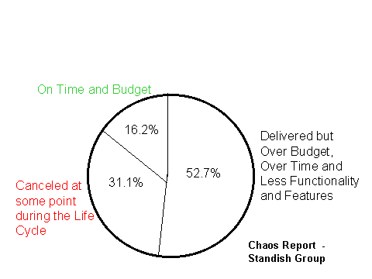
Project Success/Failure Statistics

Slide 7
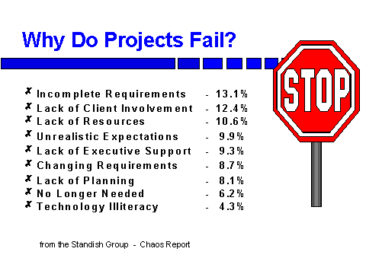
Project Success/Failure Statistics...

Slide 8
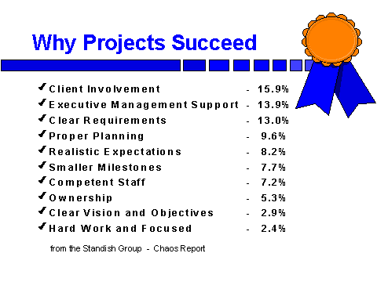
Project Success/Failure Statistics...

Slide 9
Project Management Framework

Slide 10
Agenda
Introduction
Definitions
Project, Program, Sub project
Project Management
Project Management Knowledge Area
Relationship to other Management disciplines
Project Management context
Project life cycle, Project management life cycle
Life cycle game
Project stakeholders
Organizational influences
Key General Management skills
Social-Economic-Environmental influences

Slide 11
What is a Project & related terms?
“Project”
“A temporary endeavor undertaken to create a unique product or service.”
“Program”
“A group of related projects that are managed in a coordinated way and usually include an element of ongoing activity”
What is Sub-Project??
“Every Single project contains several sub-projects, structured like a project. Each sub project will have user groups assigned to them are sub set of the parent project group. When it comes to the administration, this would require the user to be the member of the parent group before he becomes the member of the sub project.
Sub projects can be created by the parent group members who are members of sub project also. Administrator is the right person to assign the roles on the sub projects.

Slide 12
What is Project Management ?
Application of knowledge, skills, tools and techniques to project activities in order to meet or exceed stakeholder needs and expectations from the project.
Involves balancing competing demands among:
Scope, time, cost and quality
Stakeholders with different needs and expectations
Needs and expectations

Slide 13
Why use Project Management ?
Focus on Objectives: scope, cost, and time
consistent achievement
Response to rapid change
Blending multi-disciplinary skills
Focus on Stakeholders
Global competition

Slide 14
The Developer / Lead
Manage Development Processes, Coding Standards.
Fulfill the Design and Architectural requirements
Keep updated to PM on Scope, Time, Cost, HR and Quality related issues
Manage the Team and Team Deliverables
Manage the client in a professional way.

Slide 15
The Project Manager
Manages the scope and configuration management process
Must make the trade-offs between Time, Cost and Quality
Manages the Project Team
Manages the Client’s expectations

Slide 16
Processes
Projects are composed of processes. A process is “a series of actions bringing about a result”.
Classification of Project processes
Project Management processes
Product-oriented processes

Slide 17
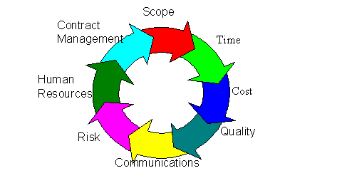
Knowledge Areas

Slide 18
Project Integration Management
Describes the process required to ensure that the various elements of the project are properly coordinated.
Processes
Project Plan development
Project Plan Execution
Overall Change Control

Slide 19
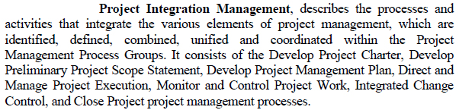
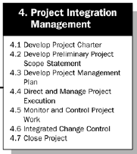
Map and Manage the Expectations of Stake Holders including End-users
High Level User Requirements
High Level System Technical Requirements
High Level Project Schedule Dates
Rough Dates to be discussed on Final Delivery / System Sign Off
Scope Derivation and Control Management Process
H/W & S/W Components

Slide 20
Project Scope Management
Describes the processes required to ensure that the project includes all the work required, and only the work required, to complete the project successfully.
Processes
Initiation, Scope planning, Scope definition, scope verification, scope change control

Slide 21
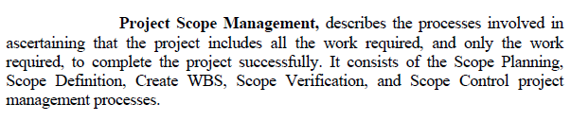
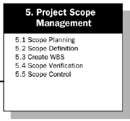
Project Scope Management
Detailed Requirements Gathering
Detailed Functional Specifications
Detailed Technical Specifications
PM Team, all Administrators, Customers
PM team and Important Customers along with end users
PM Team, Developers and Customers
Initiate and establish the Change Control Mechanism
PM, Team Leads and Project Leads with Customers.

Slide 22
Project Time Management
Describes the processes required to ensure timely completion of the project.
Processes
Activity definition, activity sequencing, activity duration estimation, schedule development, schedule control

Slide 23

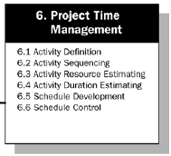
Project Time Management
Define all the Deliverables and the Schedule of all the team meetings
Project Manager and Customers (Project Leads are optional)
Assign the schedule control to the control team to monitor
PM, Control Team Mentor and Leads
Prioritize the sequence of all the activities
Assign the dates on all the tasks and assign them to the resources
Involve PM, Important Team members, Customers
Project Manager, Leads and Customers

Slide 24
Project Cost Management
Describes the processes required to ensure that the project is completed within the approved budget.
Processes
Resource Planning, cost estimating, cost budgeting, and cost control

Slide 25

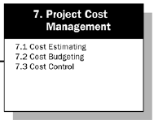
Project Cost Management
Estimate H/W and S/W components
Project Manager, Team and Procurement Department.
Provide the reports of EVM to the cost control team for further budgeting and approval on the project.
PM, Procurement Manager, Steering Committee In-charge and Cost Control Lead.
Estimate Man days, LOC (Classes, Batch codes and any other coding to integrate the system). Use proper Cost Control Techniques to estimate individual item in each category.
Miscellaneous Cost estimation for Project Execution (IS, Petty items, Travel costs, External Vendor Consultancy, Stationary, etc.)
Project Steering Committee and Project Management Committee
Project Management Team and Architects

Slide 26
Project Quality Management
Describes the processes required to ensure that the project will satisfy the needs for which it was undertaken
Processes
Quality planning, Quality Assurance, and Quality Control

Slide 27

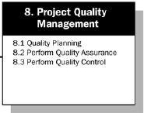
Project Quality Management
Develop a detailed Test Plan (Includes UAT plan), QA plan and the end user training before conducting the UAT
Team leads and Customers.
Conduct UAT Testing
Develop Test templates, scripts for Unit testing, System testing and System Integrating Testing.
Prepare UAT Templates for UAT testing
Project Manager and Team Leads
Project leads and Team members
Primarily Customers. Few development team members help the UAT team in proceeding the UAT.

Slide 28
Project Human Resource Management
Describes the processes required to make the most effective use of the people involved with the project.
Processes
Organizational planning, Staff acquisition, and team development

Slide 29

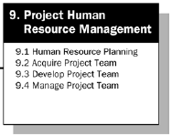
Project HR management
Plan the Human Resource required for the Project Execution (Estimate Senior Developers, Designer, Architect, Leads and Programmers)
Project Manager (Some times PM’s Supervisor also involves in this activity).
Start the project, keep updating the progress of the project to the team, conduct the individual performance reviews of the team members, work immediately on the show stoppers as and when the project is executed.
Project Manager and Project Leads and Team Leads and Administrators (DBA, Sys Admin, Net Admin)
Plan Resume Screening, Interview Activities to hire people into the project or bring in from the pool of resources with required skill sets.
Shape the team as per the approved organization structure and assign the respective duties to the team. Conduct the project briefing to the team.
Senior Management and Project Manager (if exists)
HR Manager, Project Manager and Technical Leads.

Slide 30
Project Communication Management
Describes the processes required to ensure timely and appropriate generation, collection,dissemination, storage,and ultimate disposition of project information.
Processes
Communications planning, information distribution, performance reporting, and administrative closure

Slide 31
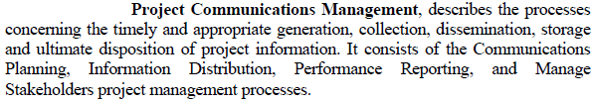
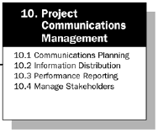
Project Communications Management
Plan all the SDLC Phases, UAT Plan, Implementation Plan and Handover Plan
Project Manager, Team Leads and the team members. Client Manager is also part of this Task.
Conduct periodical Steering Committee Meetings, Project Management Meetings and Project Team Meetings. Plan the dates well in advance and make them part of the schedule.
Project Manager, Client Manager and Steering Committee in-charge.
Keep updating all the stake holders on the status of the projects. Keep updating the Show Stoppers in advance to the stake holders.
Generate the Project Daily, Weekly, Fortnight, and Monthly reports. Keep track of the EVM and the Project Schedules. Generate the Risk Reports and update the Stake Holders.
Client Manager, Project Manager, Team Leads. Steering Committee is also part of this Plan.
Project Manager, Team Leads, Team Members and the Client Manager

Slide 32
Project Risk Management
Describes the processes concerned with identifying, analyzing, and responding to project risk.
Processes
Risk identification, Risk quantification, risk response development, and risk response control

Slide 33

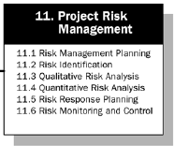
Project risk Management
Plan on a risk approach and execute the risk management activities for the project.
Project Leads, Team Members and Project Managers. Client Managers and vendors are also part of this process.
Estimate the risk cost, Time and the other factors. Determine on what to purchase or acquire and when and how .
Procurement Manager, Project Manager and Senior Management.
Identify all the risks and document them on when they will pop up in the project life cycle..
Analyze and Prioritize the Risks, Back up Plan for each and individual risk as and when they occur,
Client Manager, Project Manager and Vendors.
Project Manager, Team Leads, Team members, Vendors and Client Manager.

Slide 34
Project Procurement Management
Describes the processes required to acquire goods and services from outside the performing organization.
Processes
procurement planning, solicitation planning, solicitation, source selection, contract administration, and contract close-out.

Slide 35
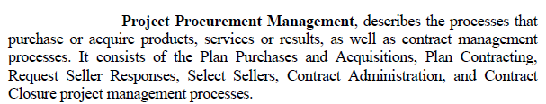
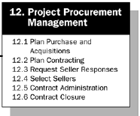
Project procurement management
Plan Purchase dates for all the software, hardware and other components using JIT
Project Managers and Administrators.
Sign off plans and Contract Renewal plannings
Client Manager, Project Manager, Procurement Manager and Administrators.
Get the dates from the administrators (DBA, SA and N/W administrator)
Plan the installations, Installation Testing and all other administration tasks.
Procurement Manger, Project Manager and Team Leads.
Project Manager and HR Manager.

Slide 36
Project Management definition revisited
“The application of Knowledge, skills, tools, and techniques to project activities in order to meet or exceed stakeholders needs and expectations from a project.”
Meeting or exceeding stakeholder requirements means balancing competing demands among:
Scope, time, cost, quality and other project objectives
Stakeholders with differing requirements
Identified requirements and unidentified requirements or expectations

Slide 37
PM Process Groups and its relationship
Project Management Processes are organized into five process groups:
Initiating Processes
Planning Processes
Controlling Processes
Executing Processes
Closing Processes

Slide 38
PM Processes and Timeline
Execution
Processes
Planning
Processes
LEVEL
OF
ACTIVITY
Initial
Processes
Closing
Processes
Controlling
Processes
Phase Start
TIME
Phase Finish

Slide 39
Description of the PM Processes
All processes defined in the 2000 PMBOK Guide are defined by Process Group and Knowledge Area
All Processes are described as:
INPUT
Tools &
Techniques
Output

Slide 40
Project Initiating Process
Initiating Process (Project)
Recognizing that a project or phase should begin and committing to do so
Intiating Process (Project Phase)
Committing the organization to begin the next phase of the project
May be formal or informal

Slide 41
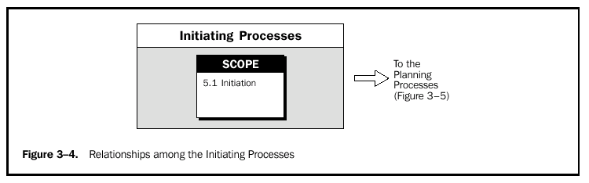

Slide 42
Project Planning Process
Devising and maintaining a workable scheme to accomplish the business need that the project was undertaken to address
Is of major important because the project involves doing something which has not been done before
Highest number of Project Management Processes are with Planning
Project Management is not primary planning

Slide 43
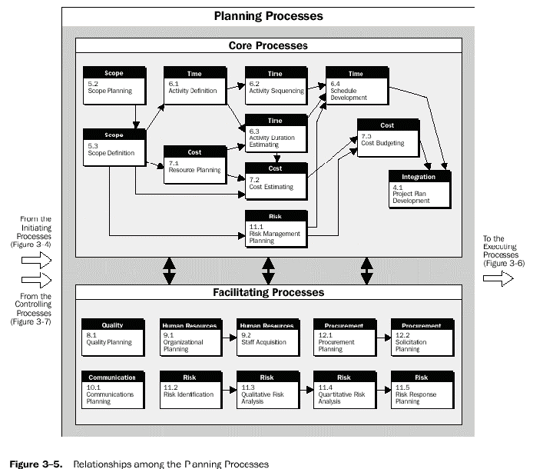
Project Planning Process

Slide 44
Project Execution Processes
Coordinating people and other resources to carry out the plan

Slide 45
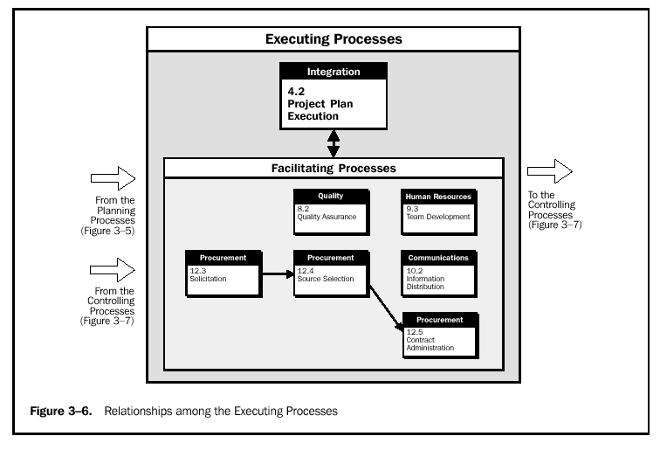
Project Execution Processes

Slide 46
Project Controlling Process
Project Performance must be measured regularly to identify variances from the plan. Variances are fed into the control process in the various knowledge areas. To the extend that significant variances are observed, adjustments to the plan are made by repeating the appropriate project planning processes

Slide 47
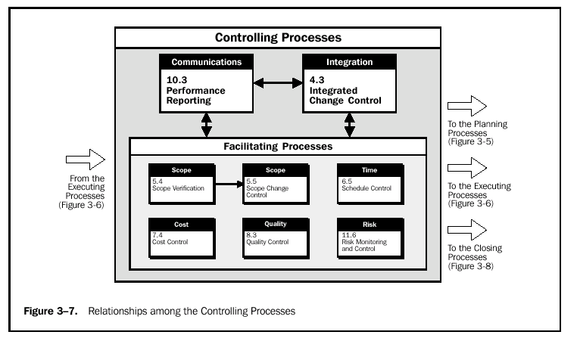

Slide 48
Project Closing Processes
Closing Process
Consisting of Administrative Closure and Contract Closure
Administrative Closure
Generating, gathering, and disseminating information to formalize phase of project completion.
Contract Closure
Completion and settlement of the contract, including resolution of any open items

Slide 49
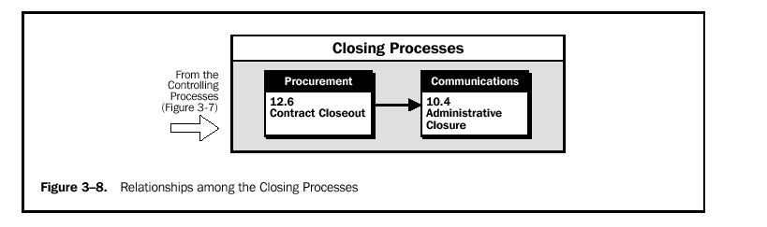

Slide 50
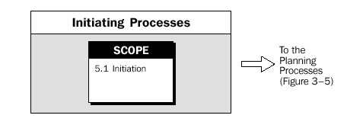
Relationship to other Management disciplines

Slide 51
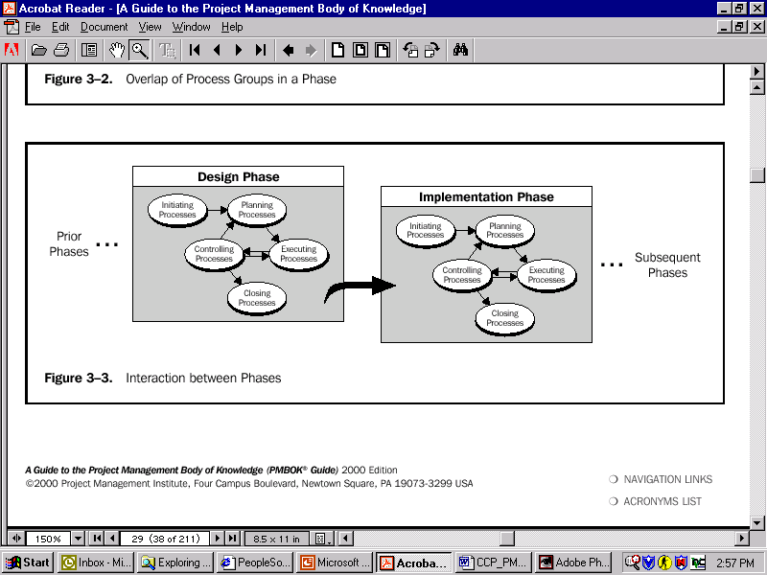
Project life cycle
Interaction between Phases

Slide 52
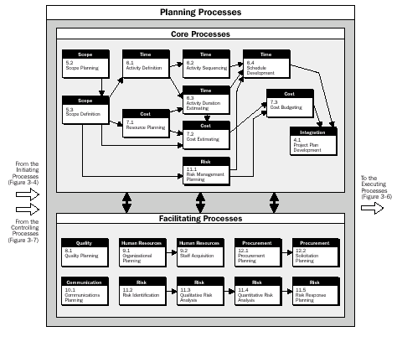

Slide 53
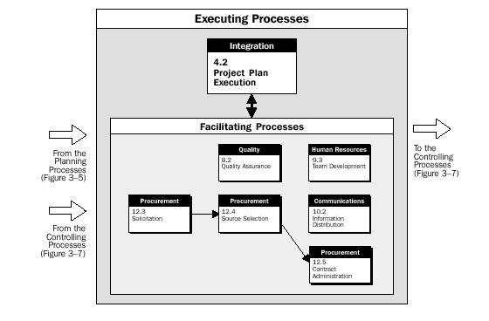
Life cycle game

Slide 54
Project Stake holders
EXTERNAL
Sub-contractors
Suppliers
External
consultants
Service providers
INTERNAL
Senior Management
Project Manager
Human Resources
Business Development
Finance
Administration
Training
Internal Systems
Quality Assurance
SEPG
CLIENT
Sponsor
Contact person
End-user
Outsource party
Appreciate interests & need for negotiations

Slide 55
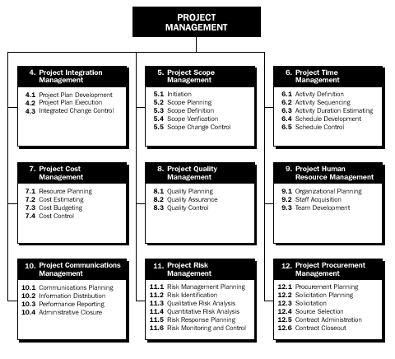
Organizational influences

Slide 56
Traditional (Functional) Organization

Slide 57
Traditional (Functional) Organization

Slide 58
Traditional (Functional) Organization

Slide 59
Traditional (Functional) Organization

Slide 60
Traditional (Functional) Organization
Executive Officer
Engg
operations
Financial
Mkt
Divisions
Departments

Slide 61
Disadvantage of the traditional Org. form
No one individual is directly responsible for the total project
Coordination becomes complex
There is no customer focal point
Difficulty in pinpointing responsibility
Ideas tend to be functionally oriented with little regard for ongoing projects

Slide 62
Pure Projectized Organization
General Manager
Project A
Manager
Project B
Manager
Project C
Manager
Eng.
Manu.
Eng.
Manu.
Eng.
Manu.

Slide 63
Advantages of the Projectized Organizational
Provides complete line authority over the project
The project participants work directly for the PM.
There are strong communications channels
Upper-level management maintains more free time for executive decision making
More Customer focus

Slide 64
Disadvantages of the Projectized Organization
Duplication of efforts, facilities and personnel
No in-depth technical knowledge
lack of career continuity and opportunity for project personnel

Slide 65
Matrix Organizational form
General Manager
Engg.
Others
PM
PM

Slide 66
Advantage of a Matrix Organizational form
PM maintains maximum project control (through the line managers) over all resources, including cost and personnel
Rapid responses are possible to changes, conflict resolution
Each person has a “home” after project completion
A strong technical base can be developed

Slide 67
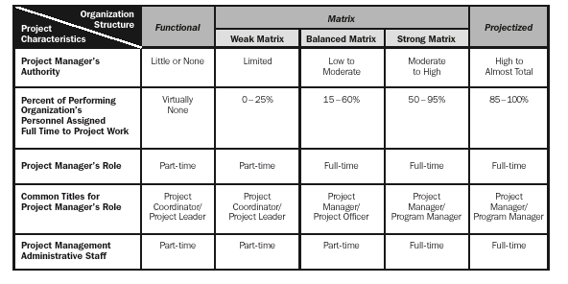
Key General Management skills

Slide 68
Social-Economic-Environmental influences

Slide 69
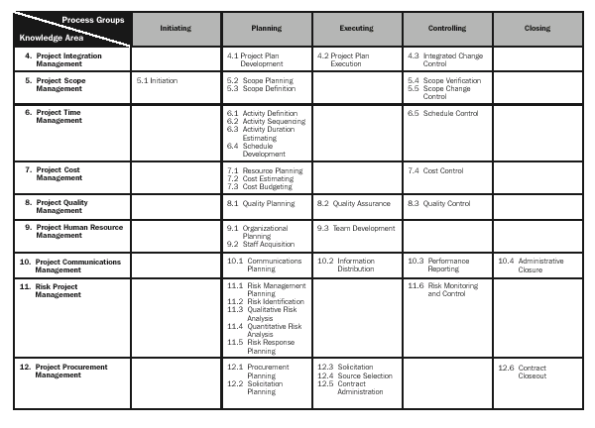
Mapping of Project Management Processes to the Project Group and Knowledge Areas

Slide 70
Project Maintenance and application area extension Activities
Problem Logs, SRs and CRs
Need for application area extension
Criteria for development of application area extension
Publishing and formatting of application area extension
Process for Development and Maintenance of application area extension

Slide 71
References:
PMBOK Materials
Rita 6 Edition PMP Materials
Internet Knowledge base.
PMP Handbook By Rita Malcauhy

Slide 72
Thank you Q & A

